Slide 1
Visual ERPs through FDA

Slide 2
Dove sono arrivato
Preprocessing
Divisione in categorie
Functional Representation
fANOVA

Slide 3
Preprocessing
FIR 0.1-12 Hz
Resample 250 Hz
Notch filter 10 Hz
ICA to remove ocular artifacts
Epochs
Maximum Peak-to-Peak amplitude 150 µV (autoreject^{[1]})
Elimino pazienti con tasso di rifiuto >= 80%
Mainak Jas, Denis A. Engemann, Yousra Bekhti, Federico Raimondo, Alexandre Gramfort, «Autoreject: Automated artifact rejection for MEG and EEG data», https://doi.org/10.1016/j.neuroimage.2017.06.030.

Slide 4
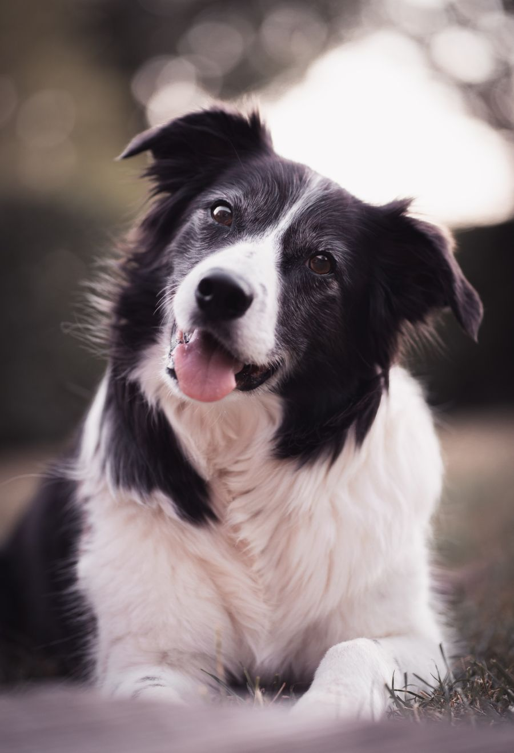
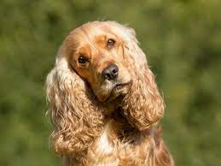
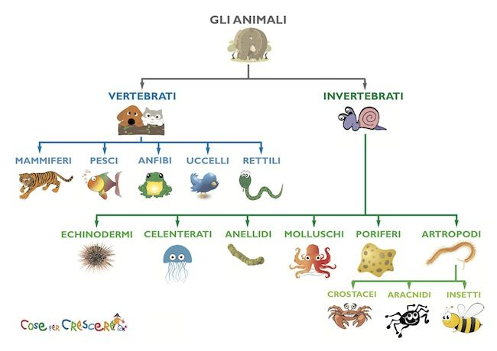

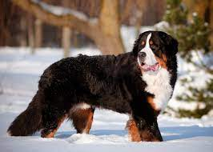
Divisione in categorie
THINGS Database
Categoria: ‘’ANIMALI’’
Concept: ‘’CANE’’
https://osf.io/jum2f/
Hebart MN, Dickter AH, Kidder A, Kwok WY, Corriveau A, Van Wicklin C, et al. (2019) THINGS: A database of 1,854 object concepts and more than 26,000 naturalistic object images. PLoS ONE 14(10): e0223792. https://doi.org/10.1371/journal.pone.0223792

Slide 5
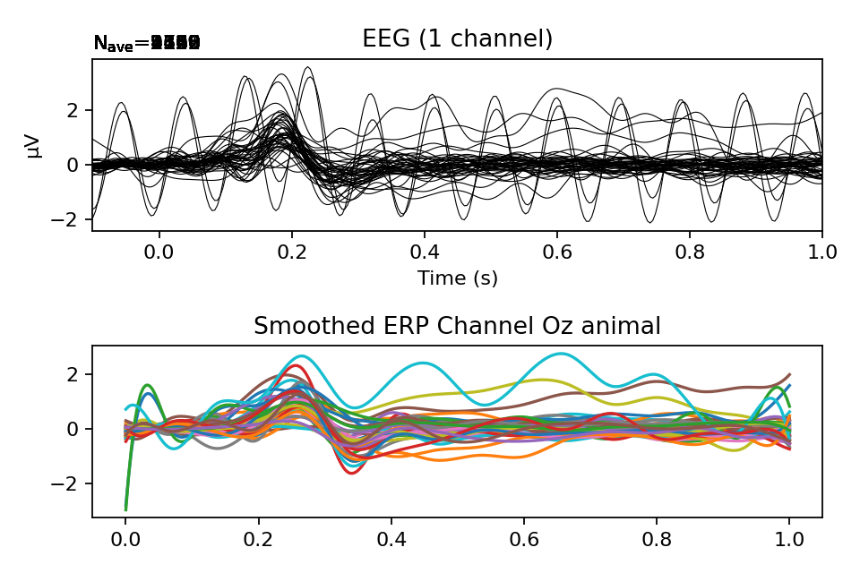
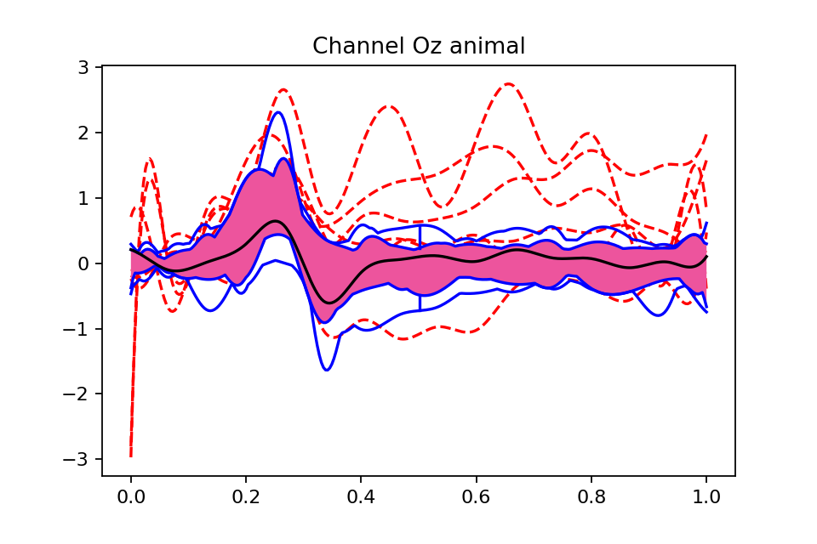
Functional Representation

Slide 6
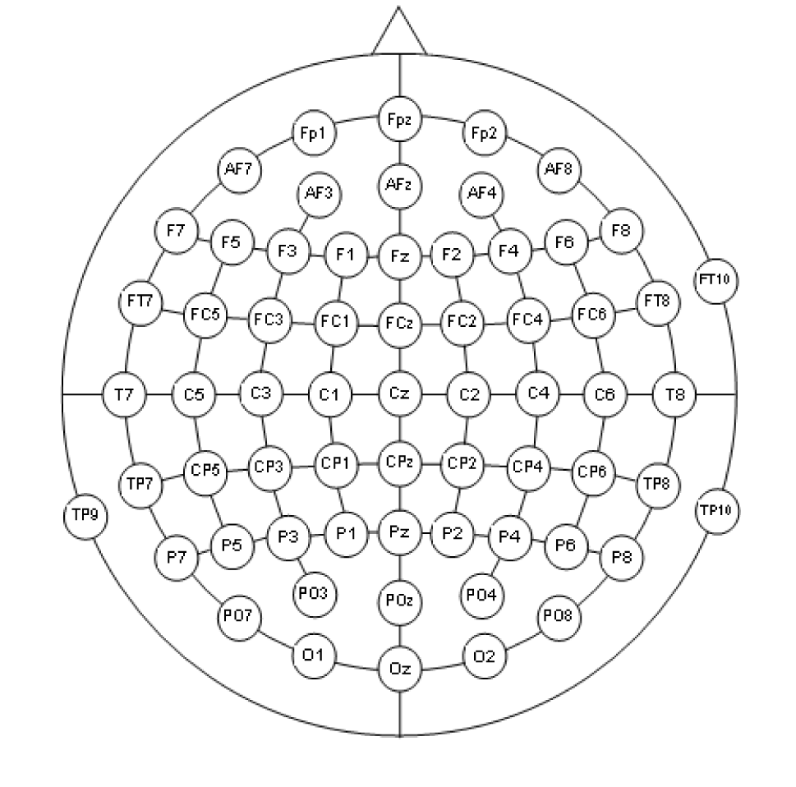




fANOVA
Gran maggioranza dei canali con differenze statisticamente rilevanti
Correzione di Hochberg

Slide 7
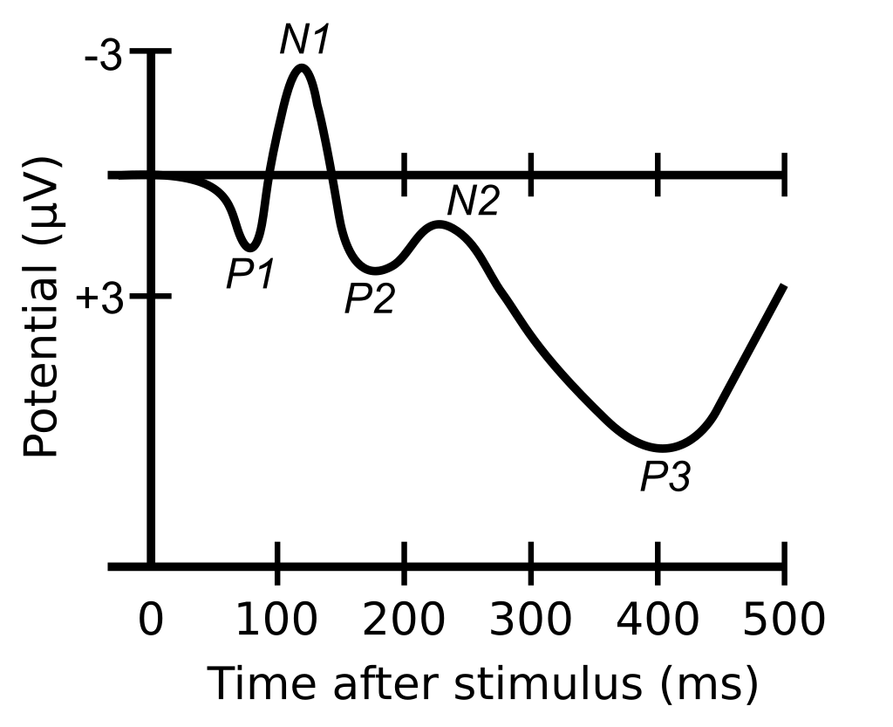
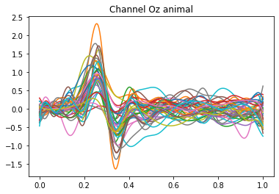
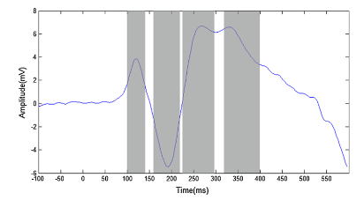
Cos’altro farei
Allineamento attraverso max e min
fPCA
P1
P2
N1
Qin Y, Zhan Y, Wang C, Zhang J, Yao L, Guo X, Wu X, Hu B. Classifying four-category visual objects using multiple ERP components in single-trial ERP. doi: 10.1007/s11571-016-9378-0. Epub 2016 Feb 18. PMID: 27468316; PMCID: PMC4947051.

Slide 8
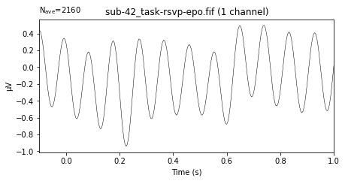
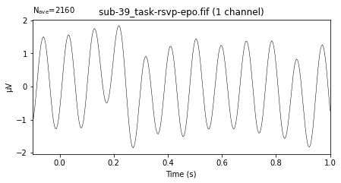
Problemi

